Slide 1
Capstone Project - 3
Credit Card Default Prediction
Team Members
Mihir Kulkarni
Ram Bakale

Slide 2
Table of contents:-
Overview and Objective
● Data Description
● Exploratory Data Analysis
● Feature Engineering
● Handling Imbalance data
● Model Building
● Model Evaluation
● Conclusion

Slide 3
Overview and Objective
Credit card is a commonly used transaction method in modern society and one of the main business of banks. For banks, it helps the bank to generate interest revenue but at the same time, it raise the liquidity risk and credit risk to the bank. In order to control the cash flow and risk, detecting the customers with default payment next month could play an important roles of estimating the potential cash flow and risk management.
The main objective of this project is to aimed at predicting the case of customers default payments in Taiwan. From the perspective of risk management, the result of predictive accuracy of the estimated probability of default will be more valuable than the binary result of classification - credible or not credible clients.

Slide 4
Data Description
Understanding attributes of dataset better:-
ID: ID of each client
LIMIT_BAL: Amount of given credit in NT dollars (includes individual and family/supplementary credit
SEX: Gender (1= male, 2=female)
EDUCATION: (1=graduate school, 2=university, 3=high school, 4=others, 5=unknown, 6=unknown)
MARRIAGE: Marital status (1=married, 2=single, 3=others)
AGE: Age in years

Slide 5
Continued….
7. PAY_0-6 : Repayment status in September- April, 2005 (-
2 = Unused, -1 = pay duly, 0=Revolving Credit, 1=payment delay
for one month, 2=payment delay for two months,8=payment delay f
or eight months, 9=payment delay for nine months and above)
BILL_AMT1-6:
2005 (NT dollar)
PAY_AMT1-6:
2005 (NT dollar)
Amount of bill statement in September- April,
Amount of previous payment in September- April,
10. default.payment.next.month: Default payment (1=yes, 0=no)

Slide 6
Approach Overview
Data Cleaning and Understanding
Find information on documented columns values
Clean data to get it ready for Analysis
Data Exploration (EDA)
Examining the data with visualization
Plotting graphs
Modelling (Machine Learning)
Logistic
SVM
Random Forest
XGBoost
Evaluation

Slide 7
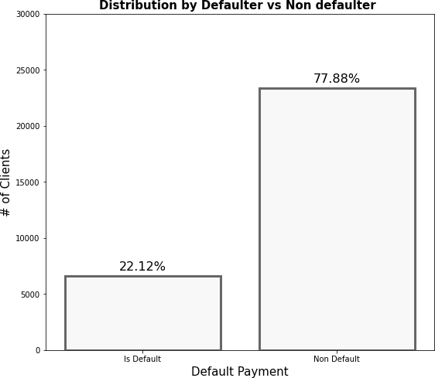
Exploratory Data Analysis (EDA)
Dependent variable
We can see that the dataset consists of more than 20000 clients who are not expected to default payment whereas around 5300 clients are expected to default the payment. Here ,there is huge difference between non-defaulter(0) and defaulter(1) .
Approx 78% are Non Defaulters and 22% are Defaulters respectively.

Slide 8
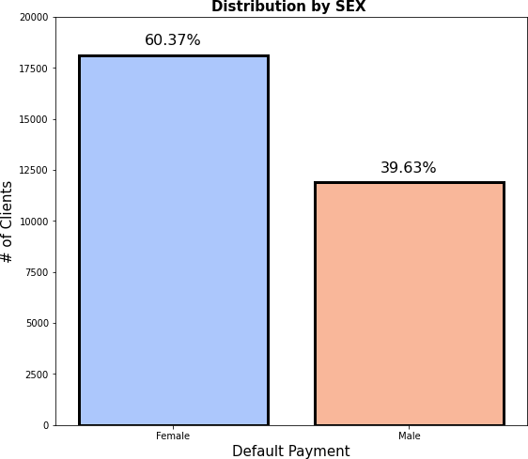
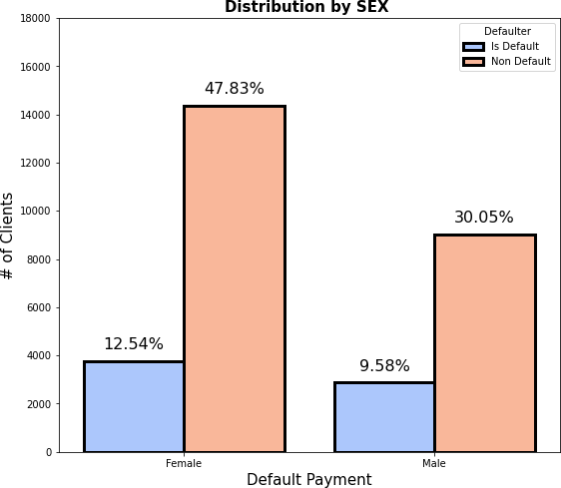
EDA Continued…
●
SEX
Number of Male credit holder (Represented as 1) is less than Female (Rrepresented as 2).
Approximately 40% are male and 60% are Female.
It is evident from the second graph that the number of defaulter have high proportion of females.

Slide 9
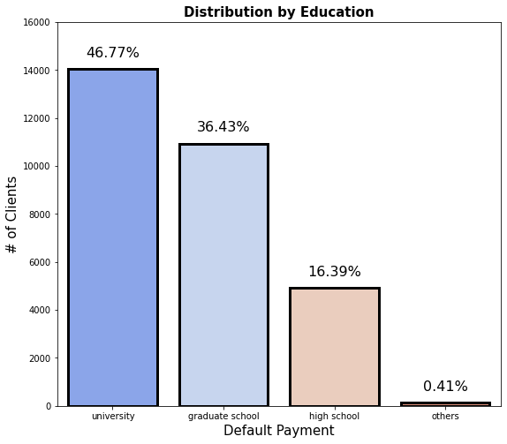
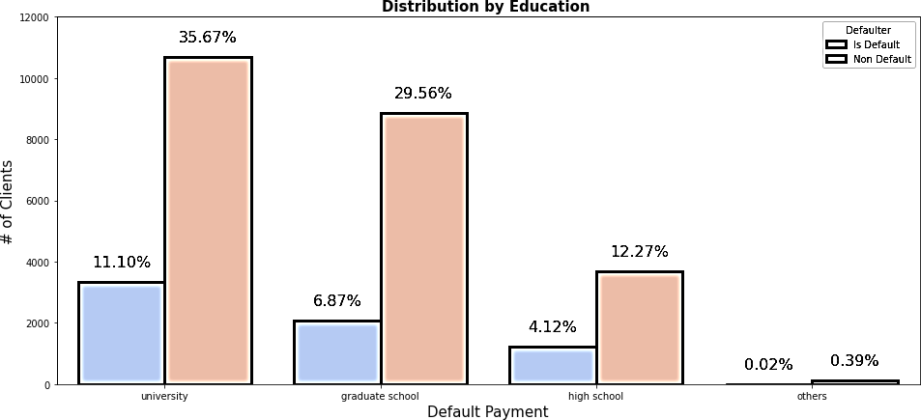
EDA Continued…
EDUCATION
More number of credit holders are university students followed by Graduates and then High school students.
From the 2nd plot it is clear that those people who are university students have higher default payment w.r.to graduates and high school people.
From university 11 % are default, from graduate 7% are default, and from high school 4% are default.

Slide 10
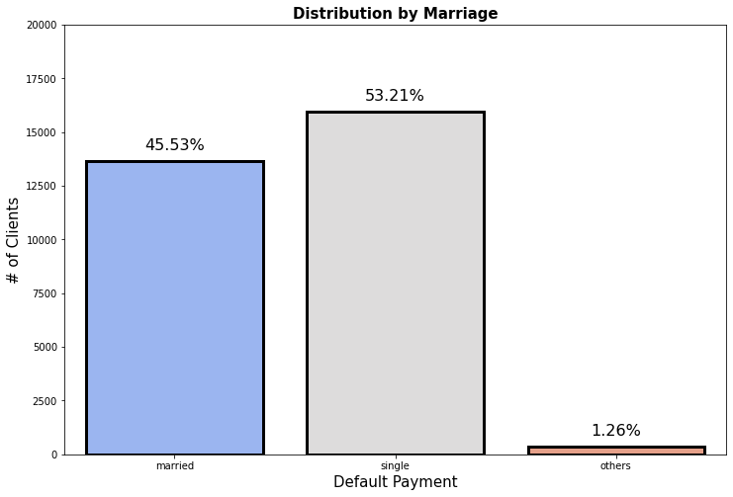
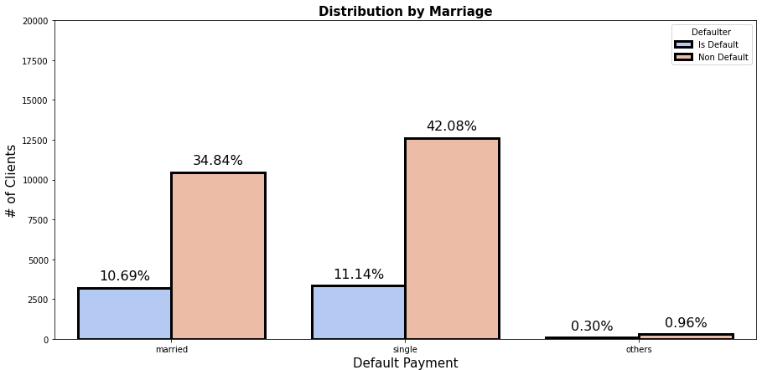
EDA Continued…
●
MARRIAGE
From graph 1 we can say that more number of credit cards holder are Single as compared to married and others.
Here it seems that married ,single are most likely to default.
From single 11% are default and from married approx 11% are defaulter.

Slide 11
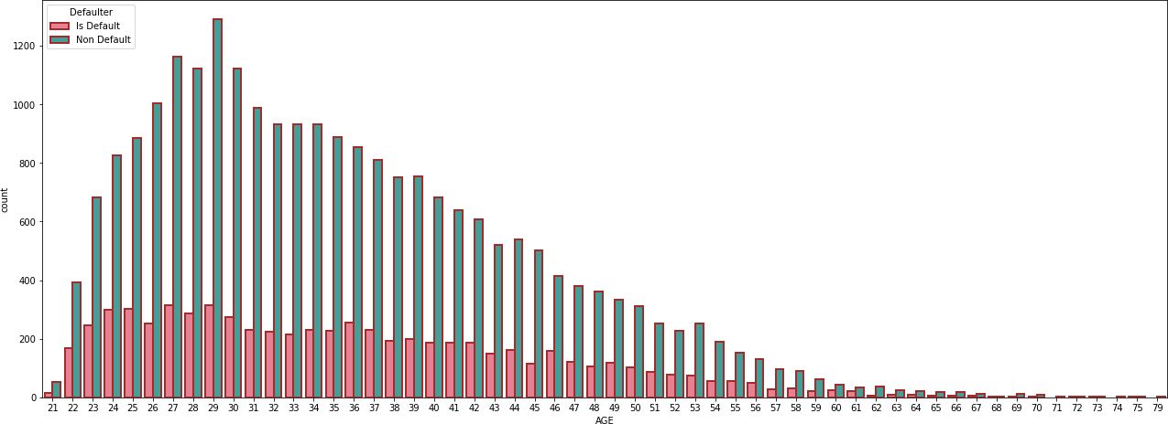
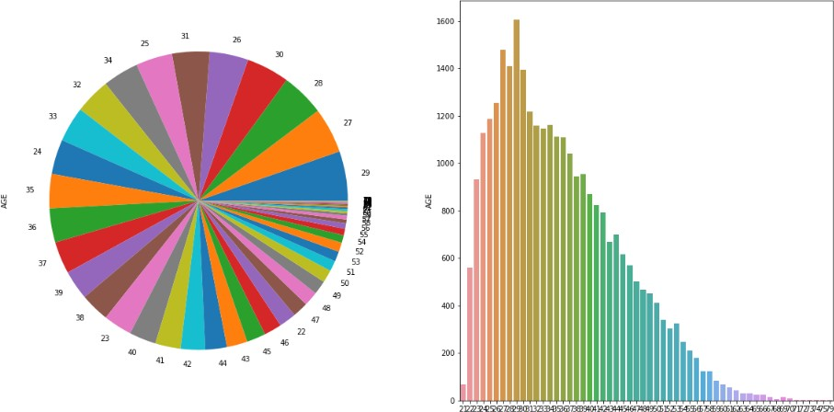
EDA Continued…
AGE
More number of credit card holders age between 26-32 years and 29 years age is the highest uses of credit card. Age above 60 years old rarely uses the credit card.
Also more number of Defaulters are between 27-29 years.

Slide 12
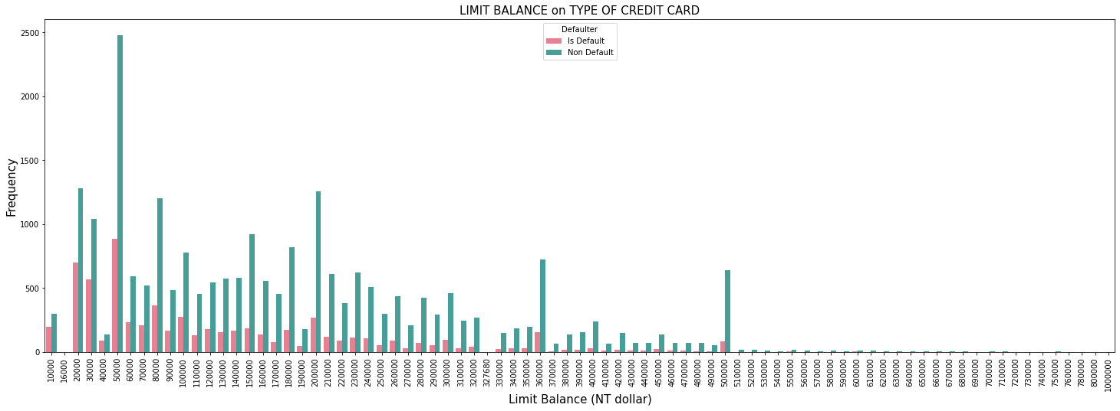
EDA Continued…
LIMIT BALANCE
Maximum amount of given credit in NT dollars is 50,000 followed by 20,000 and 30,000. And Defaulters are between this Limit Balance only.

Slide 13
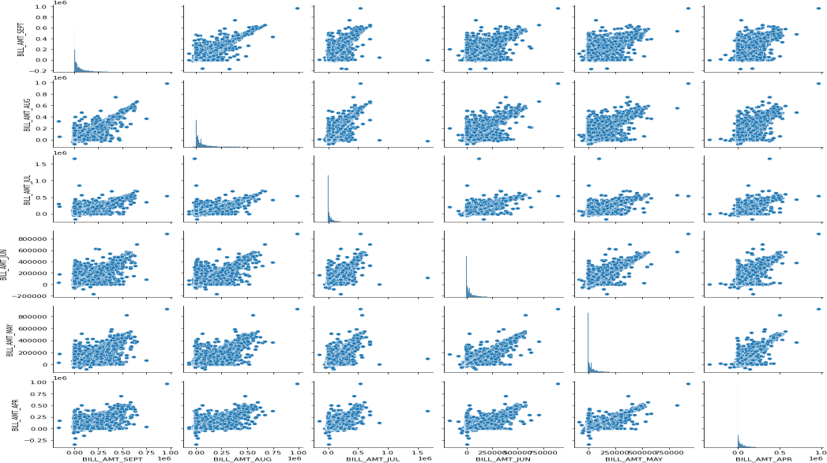
EDA Continued…
Pairplot of Bill
The adjacent Pairplot shows the distribution of bill amount statements for each month explicitly for defaulters and non-defaulters.

Slide 14
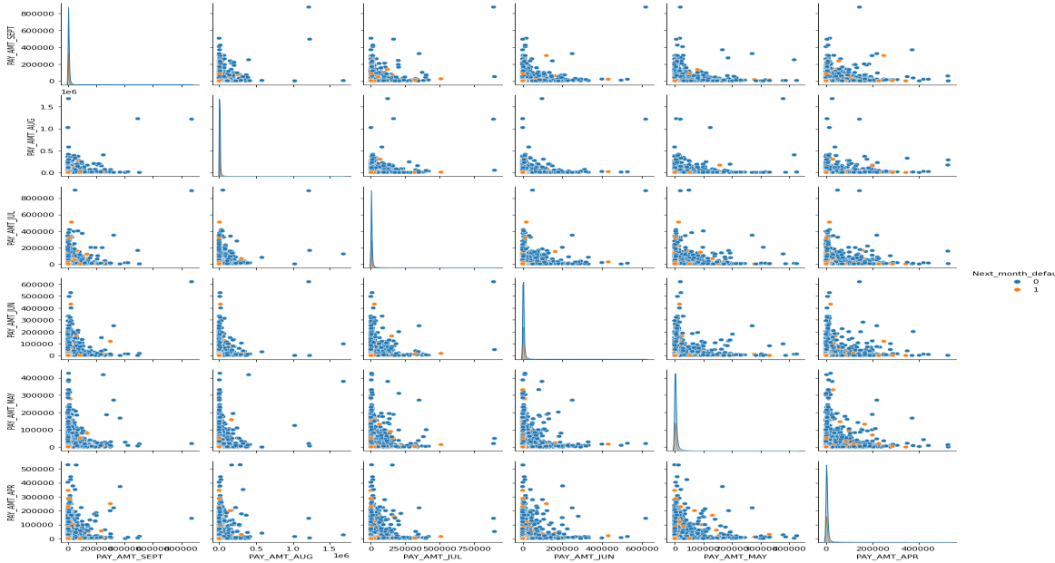
EDA Continued…
Pairplot of pay
The adjacent Pairplot shows the distribution of payment statements for each month explicitly for defaulters and non-defaulters.

Slide 15
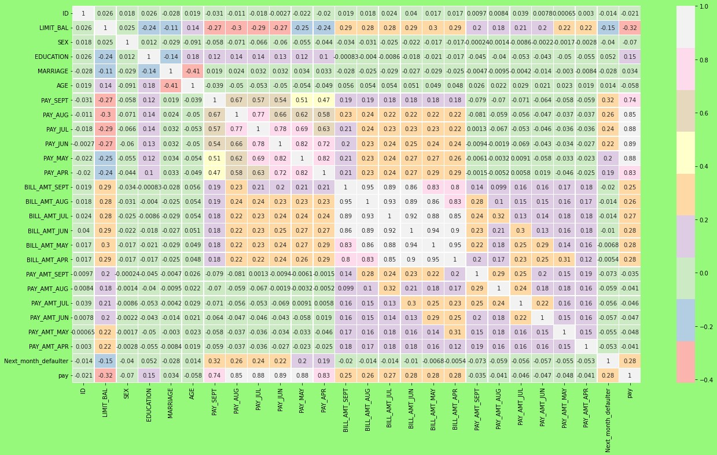
Feature Engineering
One Hot Encoding:
One hot encoding is a process by which categorical variables are converted into a numerical variables. Here we perform one hot encoding on 'EDUCATION', 'MARRIAGE', and 'SEX’.
Correlation Analysis:
We draw heatmap to find correlation between different independent features and dependent feature.
We remove columns which are not important for further analysis such as ID, AGE,DEFAULTER and PAY.

Slide 16
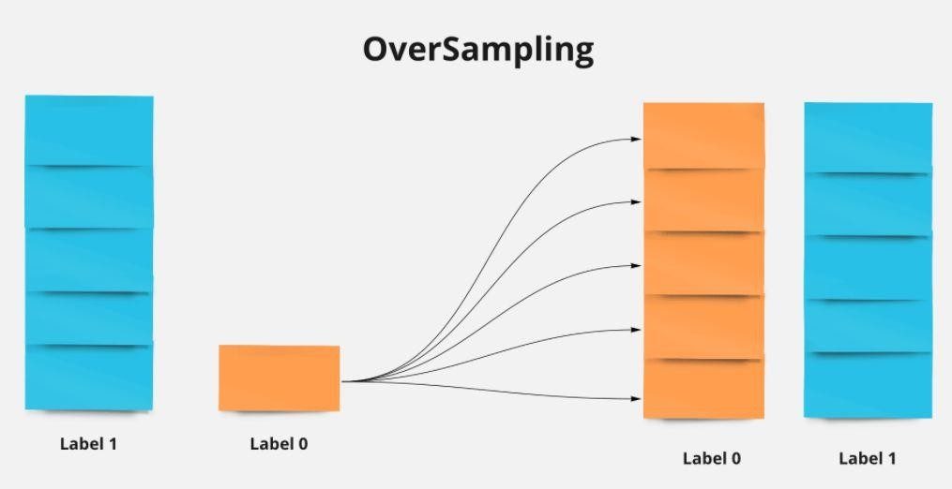
Resampling
Why resampling?
Our dataset is imbalanced
Solution:
Create new training dataset: (on X train and y train)
❏ Oversampling training data
consists in over-sizing the minority class by adding observations.

Slide 17
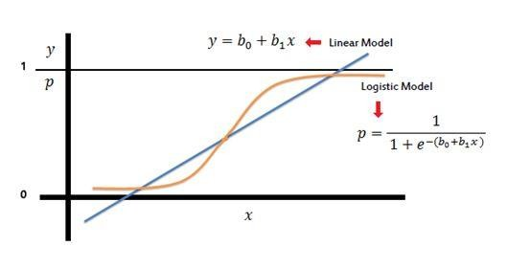
Model Building:
LOGISTIC REGRESSION
Logistic Regression is a Machine Learning algorith and it is basically used for binary classifications like yes-no, true-false, male-Female, etc.
It take the linear combination and apply a sigmoid function (logit).The Sigmoid curve gives value between 0 & 1.

Slide 18
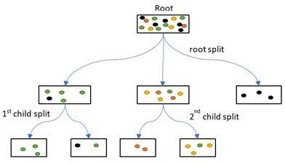
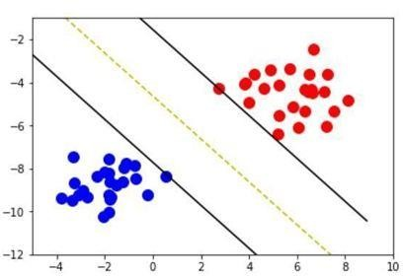
MODEL BUILDING (continued):
DECISION TREE CLASSIFIER
It is a graphical representation for getting all the possible solutions to a problem/decision based on given conditions.
The objective of Decision tree algorithm is to find the relationship between the target column and the independent variables and Express it as a tree structure.
SUPPORT VECTOR MACHINE
Maximize the distance from the yellow line (decision boundary) that separates the data
Black lines are support vectors that used to
determine the decision boundary
Can be used to classify non-linear relationship

Slide 19
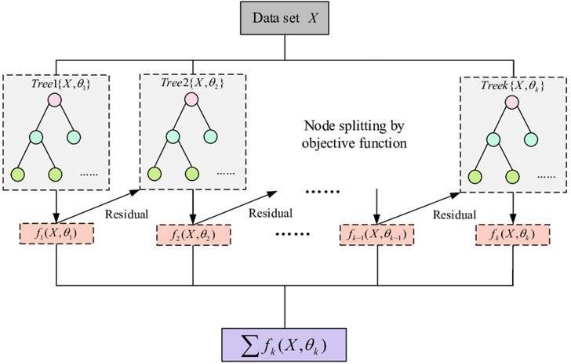
MODEL BUILDING (continued):
XG BOOST CLASSIFIER
Stands for:– eXtreme Gradient Boosting.
XGBoost is a powerful iterative learning algorithm based on gradient boosting.
Regularisation to avoid overfitting
Tree pruning using depth-first approach
It is generally used for very large dataset

Slide 20
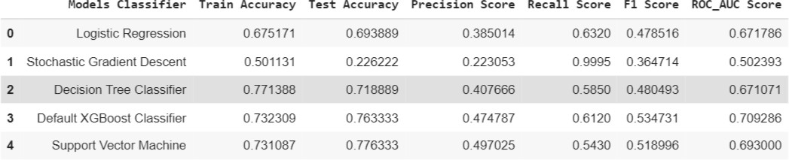
Model Evaluation:

Slide 21
Conclusion:
From the data , we see around 78% are non defaulter and 22% are defaulter. Also, when we check for Marriage, Education, Sex with respect to defaulter and we found in marriage more number of defaulter is Female, in Education more no. of defaulter is university Students and in Marriage more no. of defaulter is single.
We see that with the help of correlation matrix age and marriage are highly
negatively correlated to each other and we drop some columns we are not in
used.
3. From Above data ,We observe following :
a.) Using a Logistic Regression classifier, we can predict with 69.38% accuracy,
whether a customer is likely to default next month.
.

Slide 22
Continued…
b.) With Decision Tree classifier, 71.88% customer is likely to default next month.
c.) With Default XGBoost Classifier, 76.33% customer is likely to default next month d.) And with Support Vector Machine classifier, 77.63% customer is likely to default next month.
After that we build the Four models Logistic Regression, Decision Tree, Default XGBoost Classifier & Support vector machine and in spite of all the models, the best accuracy is obtained from the Default XGBoost Classifier.

Slide 23
THANK YOU!!

